Slide 1
High Performance Intrusion Detection Using HTTP-Based Payload Aggregation
2017 IEEE 42nd Conference on Local Computer Networks (LCN)
Author: Felix Erlacher, Falko Dressler
Presenter: Cheng-Feng Ke
Date: 2018/01/10
Department of Computer Science and Information Engineering
National Cheng Kung University, Taiwan R.O.C.
Notes:
1

Slide 2
RELATED WORK
A very generic approach is to use the first 500 kB of every flow [21]. It has been shown that 99 % of the threats are located in this portion of the network traffic. This is very similar to early filtering algorithms such as Front Payload Aggregation (FPA) [10].
A first step towards handling more complex application protocol behavior focusing on HTTP/1.0 has been addressed in [11]. The presented DPA approach collects the first N bytes after every TCP direction change, i.e., keeping track of multiple HTTP request / response pairs in the same transport layer connection.

Slide 3
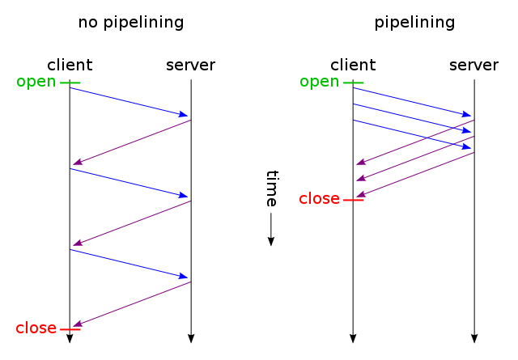
RELATED WORK
HTTP pipelining is a technique in which multiple HTTP requests are sent on a single TCP connection without waiting for the corresponding responses.

Slide 4
INTRODUCTION
Filters have been proposed to reduce the amount of traffic to be analyzed by a NIDS, yet, such filters need to be very carefully designed in order not to miss relevant data.
We address this problem by proposing a novel concept for filtering taking into account the pipelining architecture of modern web traffic.
Our concept, which we named HTTP-based Payload Aggregation (HPA), is able to retain the first N bytes of the basic Protocol Data Unit (PDU) of an application layer protocol and discard the rest, arguing that the retained payload portion contains almost all relevant data for intrusion detection.

Slide 5
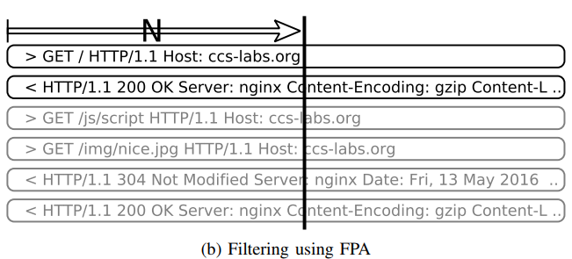
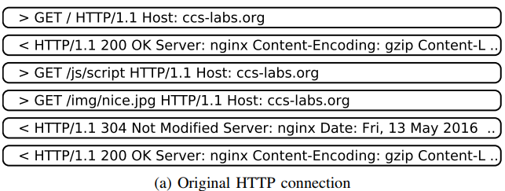
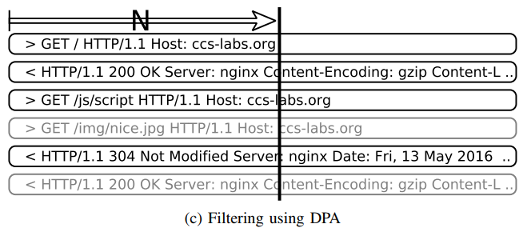
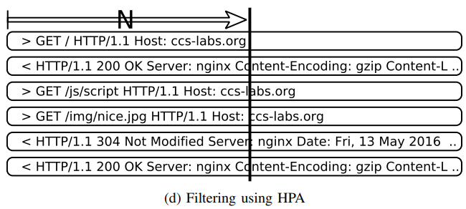
HPA: HTTP-BASED PAYLOAD AGGREGATION

Slide 6
Snort rules (snapshot 2990)
We then filtered all rules so that only active (uncommented) rules remained that were related to HTTP:
67 % (18363) of all active rules (27375) are related to HTTP (using http_* content restrictors, using the “service http” metadata tag or using the $HTTP_SERVER or $HTTP_PORTS variable);
42 % (11468) of the rules apply the pattern to a field in the HTTP header and thus the beginning of the HTTP message.

Slide 7
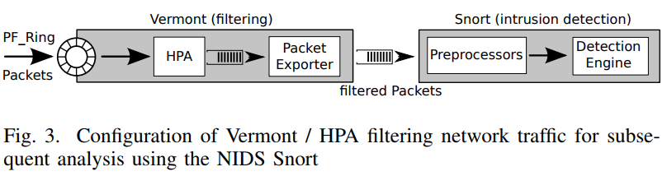
Implementation
For implementing our new algorithm, we use the network monitoring toolkit Vermont [23].
We use the capability of the HTTP parser to filter out only the first N bytes of every HTTP message (request and response) and then export these bytes as one packet per message to the NIDS Snort.

Slide 8
EVALUATION
To represent typical HTTP traffic, we use a trace that was created by capturing the traffic going through an HTTP proxy used by a scientific work group for one week (from now on called proxy trace).
In total the trace contains more than 2.2 million packets divided among 2996 unique IP Flows (IP source/destination pairs).
The average packet size is 825 B.
We used Snort version 2.9.9.0 in IDS mode with the default snort.conf configuration file.

Slide 9
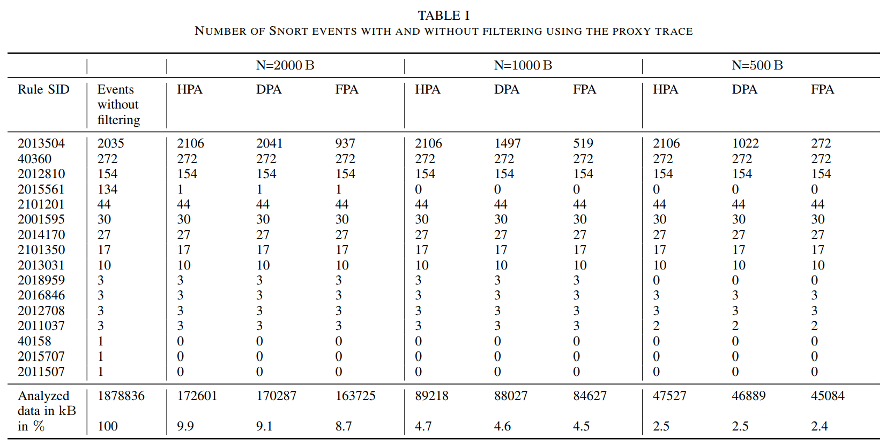
EVALUATION

Slide 10
EVALUATION
We assessed the overall system performance using a realistic scenario by replaying the previously used proxy trace between two workstations (Linux 3.2.0, i5-4440 CPU, 32 GB RAM), which are directly connected over a 10 Gbit/s Ethernet network (Intel 82599 NICs).
The goal was to measure the workload processing capacity (in our case packet throughput) and to assess the influence of our filtering system. We adapted the proxy trace used above for the performance tests by repeating the trace 15 times.
The result is a trace with 33 million packets and 28 GB of data. To replay the network trace, we used the program pfsend from the PF_Ring program suite [26], which is more accurate than the well-known tcpreplay.

Slide 11
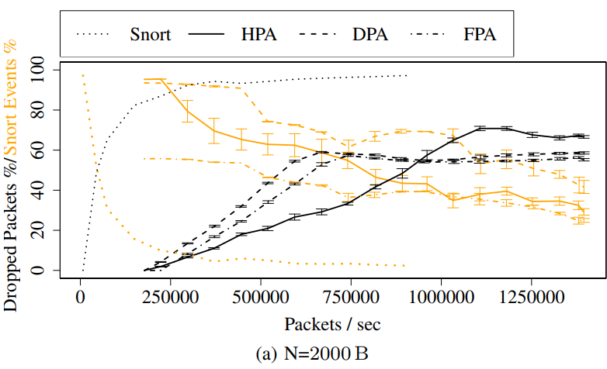
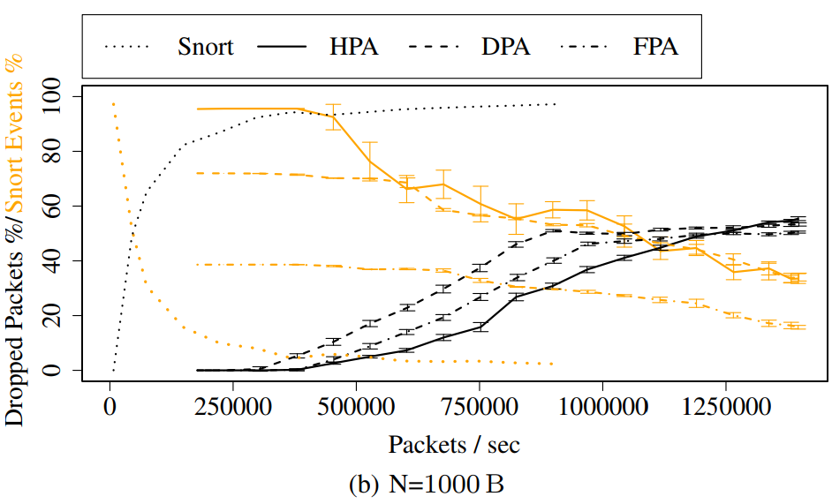
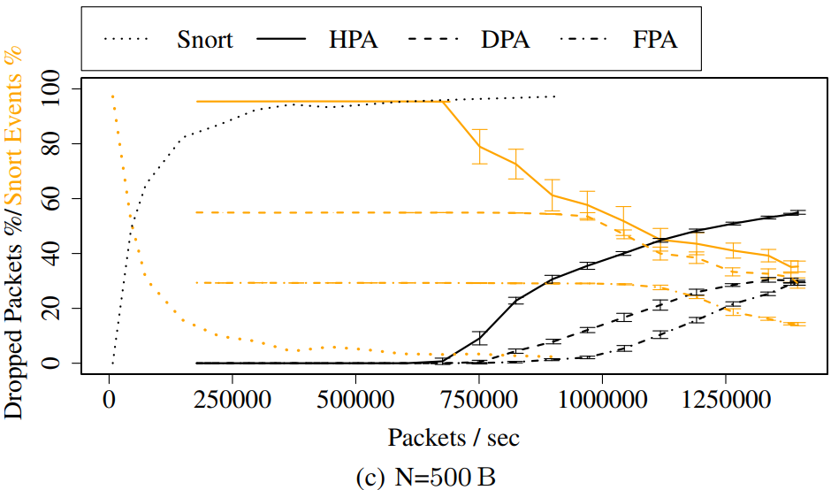
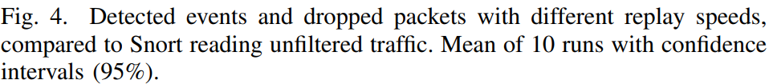
EVALUATION

Slide 12
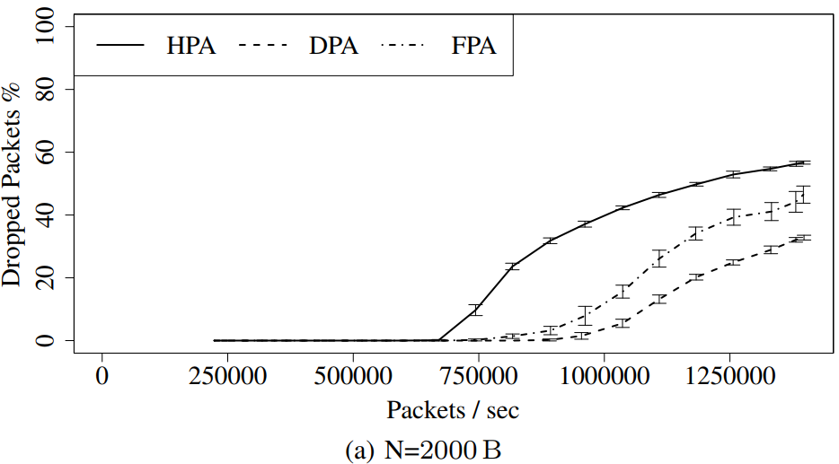
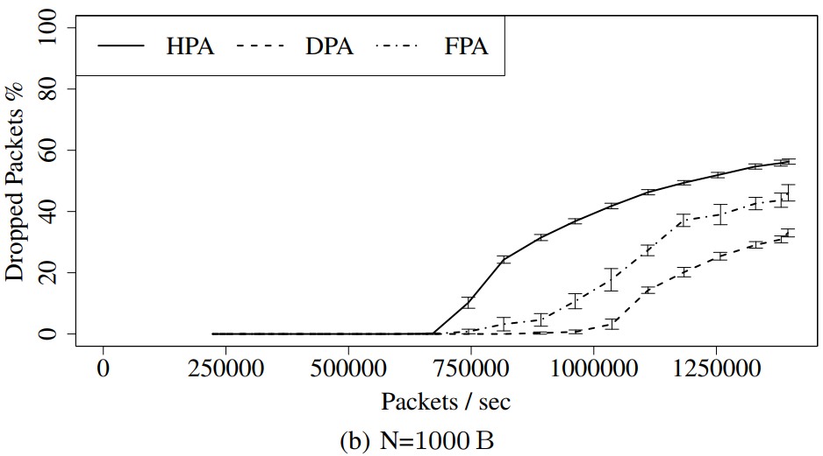
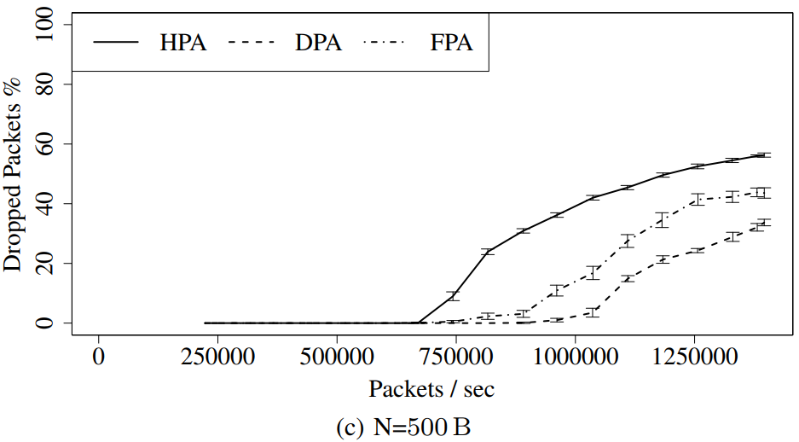
EVALUATION

